Slide 1
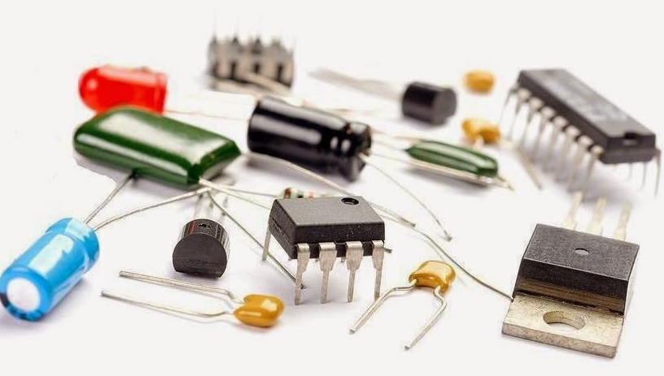
Chapter 1- Introduction of Electronic Devices
-Mrs Rasika B. Naik

Slide 2
Points to be covered in todays class
DC Load Line analysis
Common Base Configuration
Input Output Characteristics of CB configuration
Common Collector Configuration
Input Output Characteristics of CC configuration
Comparison of CE, CB and CC

Slide 3
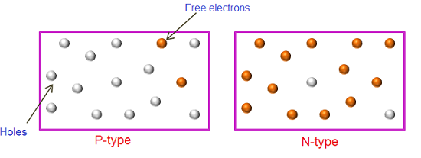
PN Junction
n-type semiconductor
formed by adding pentavalent impurities (like Phosphorus (P), Arsenic (As), Antimony (Sb)) to the intrinsic semiconductor.
electrons are the majority carriers while holes are the minority carriers.
p-type semiconductor
formed by adding trivalent impurities (like Boron (B), Gallium (G), Indium(In), Aluminium(Al)) to the intrinsic semiconductor.
holes are the majority carriers while electrons are the minority carriers.

Slide 4
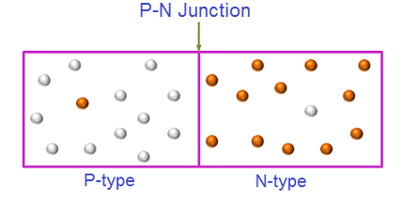
Formation of p-n junction
when an n-type semiconductor is joined with the p-type semiconductor, a p-n junction is formed.
The region where the p-type and n-type semiconductors are joined is called p-n junction.
It is also defined as the boundary between p-type and n-type semiconductor.
This p-n junction forms a most popular semiconductor device known as diode.
The credit of discovery of the p-n junction goes to American physicist Russel Ohi of Bell Laboratories.

Slide 5
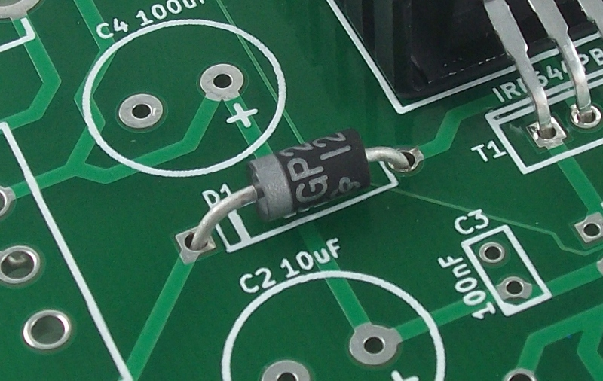
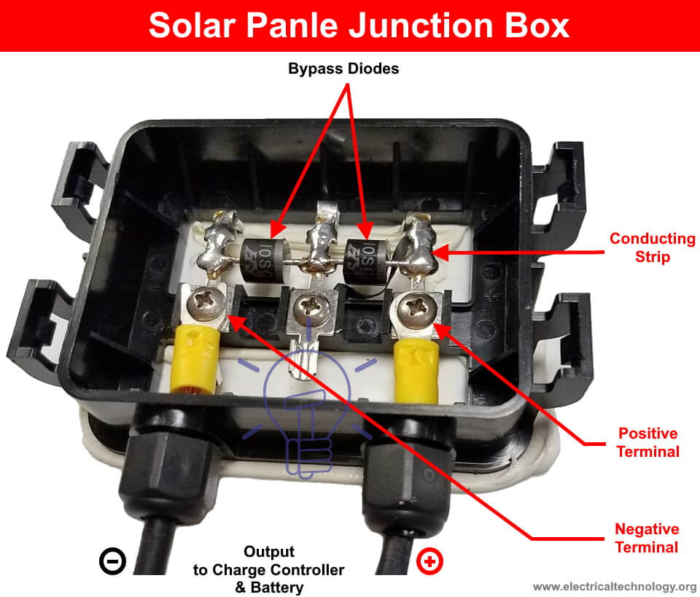

Why are we studying diodes/semiconductor devices?
Diodes are the simplest form of all the semiconductor devices.
Semiconductor devices are the fundamental building blocks of all the electronic devices such as computers, control systems, ATM (Automated Teller Machine), mobile phones, amplifiers, etc.
The various applications of diodes include computers, power supplies, television, radios and so on.

Slide 6
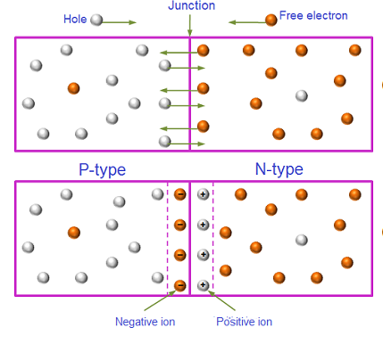
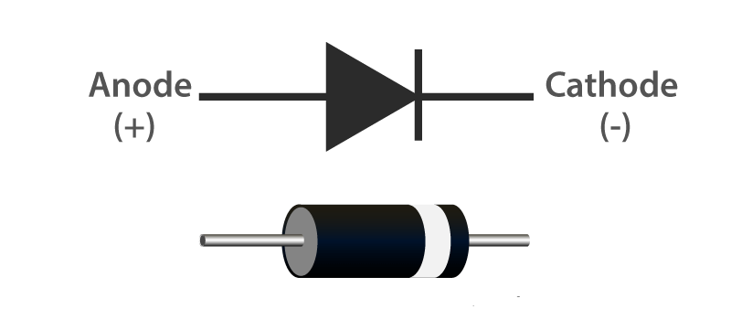
PN Junction Diode
Symbol of PN junction Diode
Zero biased or Unbiased PN junction Diode
What is Depletion Region ??

Slide 7
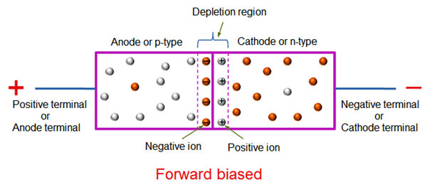
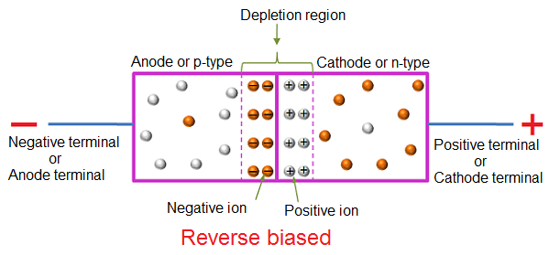
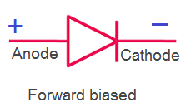
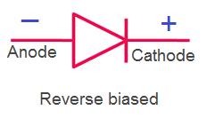
Biasing of p-n junction Diode
The process of applying the external voltage to a p-n junction semiconductor diode is called biasing.
External voltage to the p-n junction diode is applied in any of the two methods: forward biasing or reverse biasing.

Slide 8
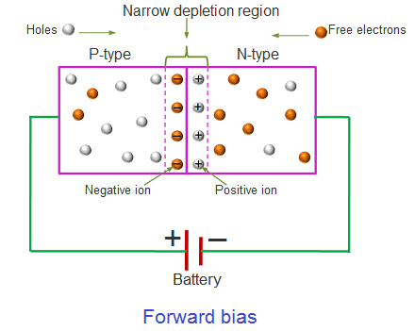
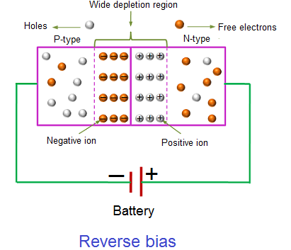
Forward Bias And Reverse Bias

Slide 9
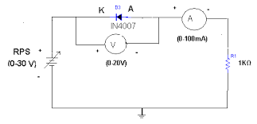
Circuit arrangement to plot VI characteristics of Diode

Slide 10
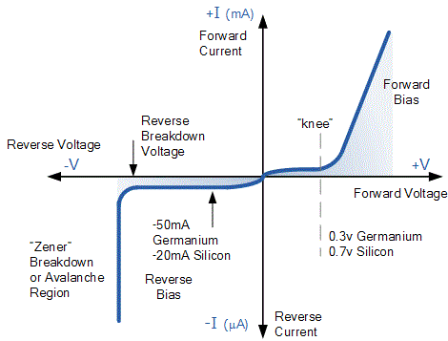
VI characteristics of PN junction Diode

Slide 11
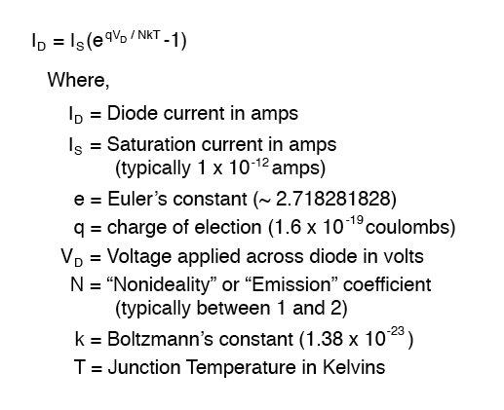
Diode Current Equation

Slide 12
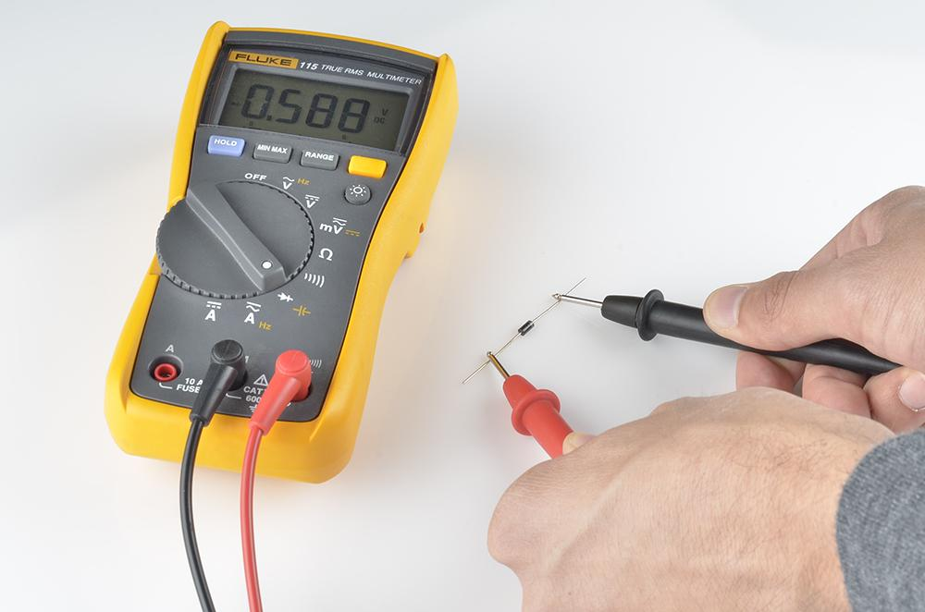
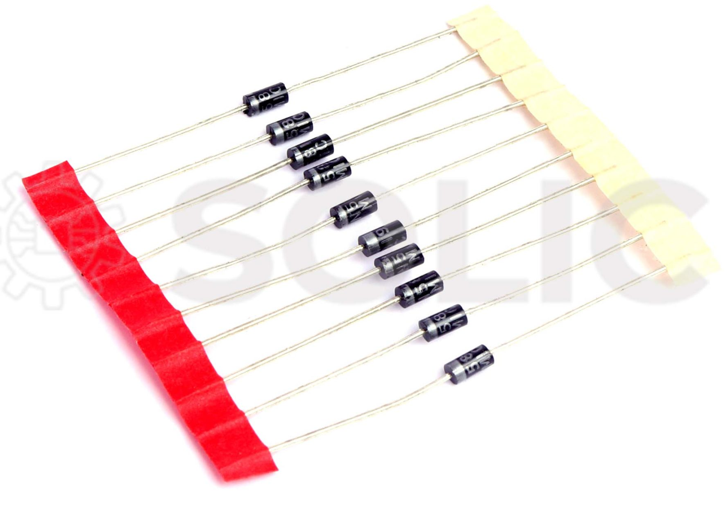
How to test the Diode?

Slide 13
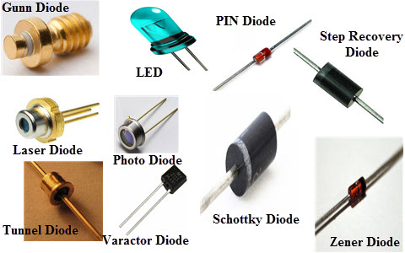
Types of Diodes

Slide 14
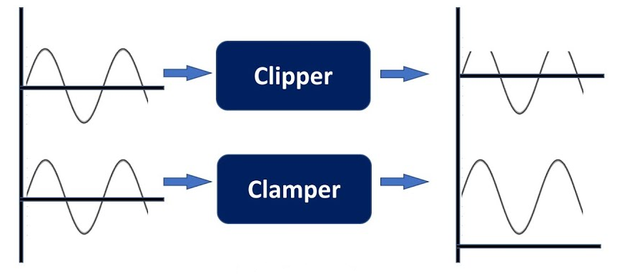
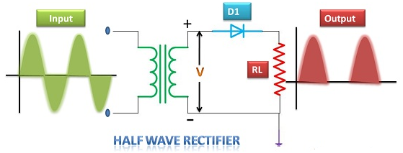
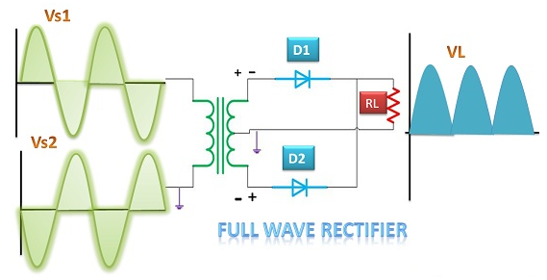
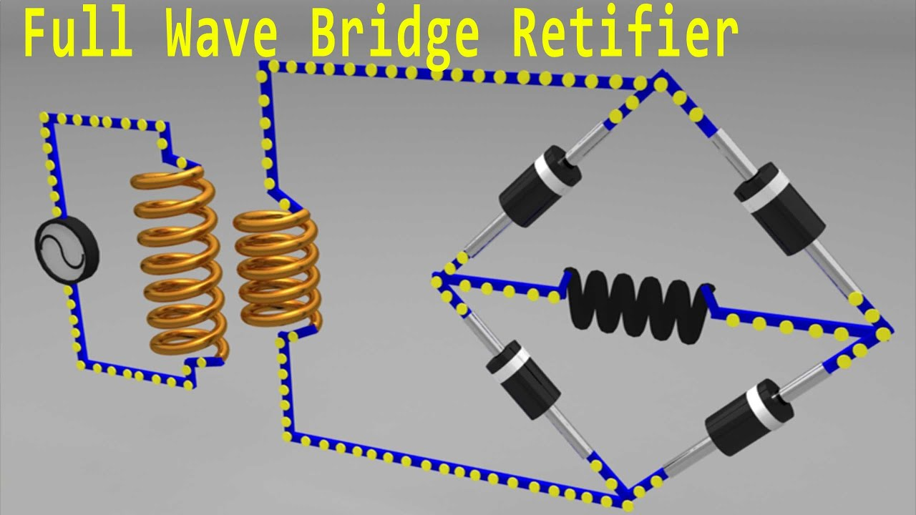
Applications of Diode
Clipper Clampers-clips or clamps the waveform
Rectifiers:
Converts AC voltage into DC voltage
A HWR allows current to flow during half the AC cycle.
A FWR allows current to flow during both half AC cycles.
Transistors:
Used to amplify small signals

Slide 15
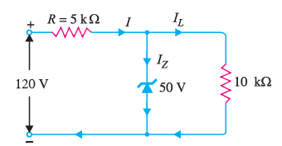
Numerical on Zener Diode
Ex. 1) For the circuit shown in given Figure
find : (i) the output voltage
(ii) the voltage drop across series resistance
(iii) the current through zener diode.

Slide 16
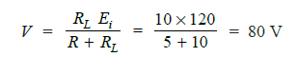
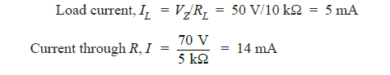
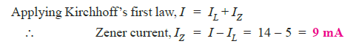
Solution of Ex 1
If you remove the zener diode in Fig. 1, the voltage V across the open-circuit is
Since voltage across zener diode is greater than V_{Z} (= 50 V), the zener is in the “on” state. It can, therefore, be represented by a battery of 50 V

Slide 17
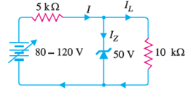
Numerical on Zener Diode
Ex.2) For the circuit given
(i),find the maximum and minimum values of zener diode current.

Slide 18
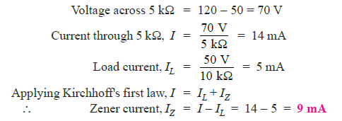
Solution of Ex 2
Maximum zener current: The zener will conduct maximum current when the input voltage is maximum i.e. 120 V. Under such conditions :

Slide 19
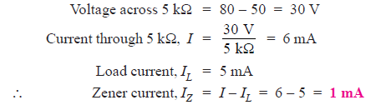
Solution of Ex 2
Minimum Zener current: The zener will conduct minimum current when the input voltage is minimum i.e. 80 V. Under such conditions, we have,

Slide 20
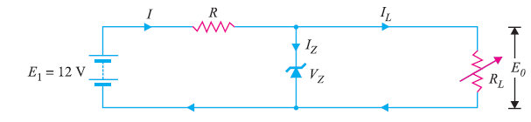
Numerical on Zener Diode
Ex. 3) A 7.2 V zener is used in the circuit shown in Fig. 3 and the load current is to vary from 12 to 100 mA. Find the value of series resistance R to maintain a voltage of 7.2 V across the load. The input voltage is constant at 12V and the minimum zener current is 10 mA.

Slide 21
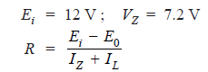
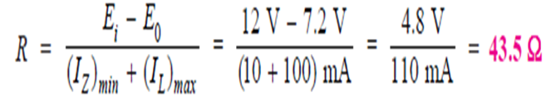
Solution of Ex 3
The voltage across R is to remain constant at 12 − 7.2 = 4.8 V as the load current changes from 12 to 100 mA. The minimum zener current will occur when the load current is maximum.
If R = 43.5 Ω is inserted in the circuit, the output voltage will remain constant over the regulating range. As the load current I_{L} decreases, the zener current I_{Z} will increase to such a value that I_{Z} + I_{L} = 110 mA.
Note that if load resistance is open-circuited, then I_{L} = 0 and zener current becomes 110 mA.

Slide 22
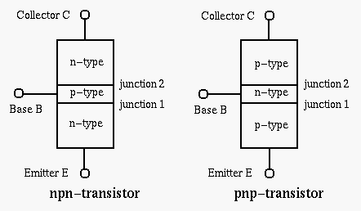
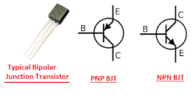
Bipolar Junction Transistor (BJT)
BJT is a semiconductor device which can be used for switching or amplification

Slide 23
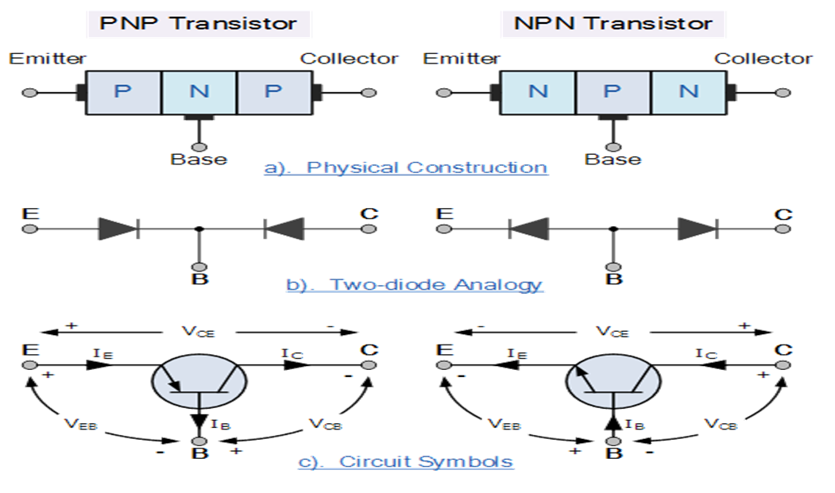
Two Diode Analogy of Transistors

Slide 24
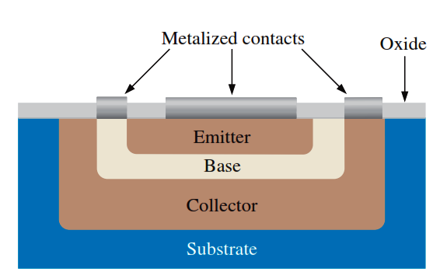
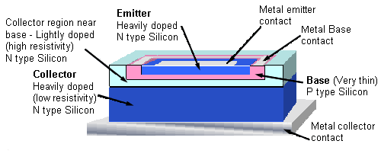
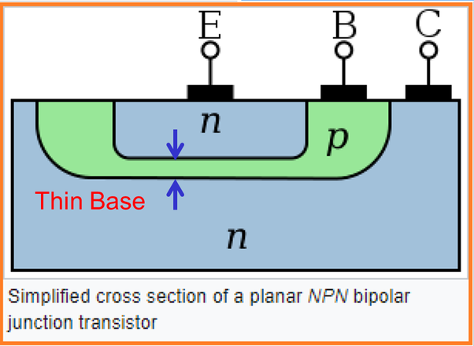
Construction of BJT

Slide 25
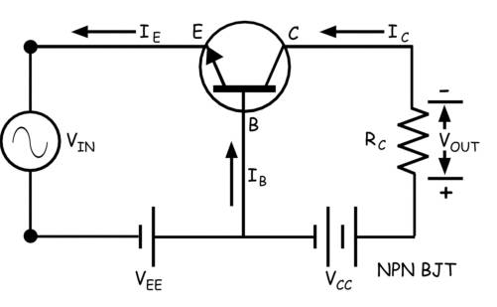
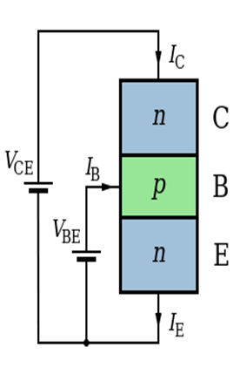
Working of NPN Transistor
NPN Transistor : EB junction-Forward Biased CB junction-Reverse Biased

Slide 26
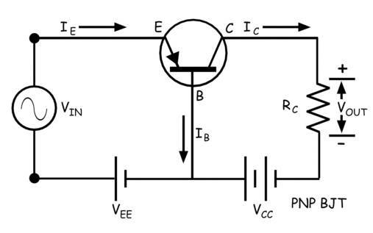
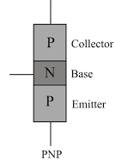
Working of PNP Transistor
PNP Transistor : EB junction-Reverse Biased CB junction- Forward Biased

Slide 27
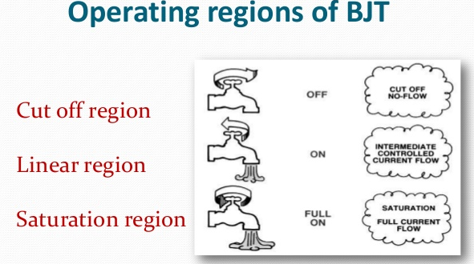
Active Region – the transistor operates as an amplifier and Ic = β*Ib
Saturation – the transistor is “Fully-ON” operating as a switch and Ic = I(saturation)
Cut-off – the transistor is “Fully-OFF” operating as a switch and Ic = 0

Slide 28
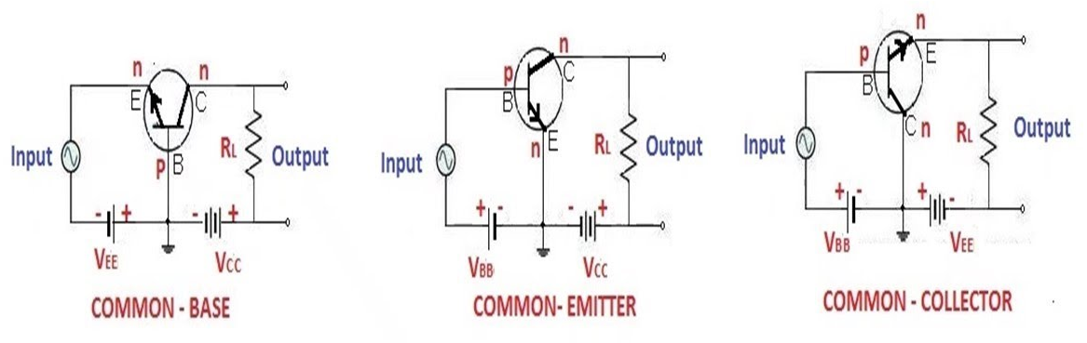
Configurations of BJT

Slide 29
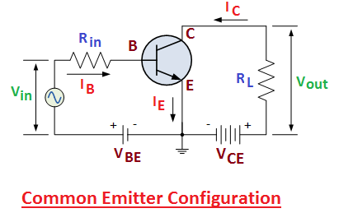
Common Emitter Configuration

Slide 30
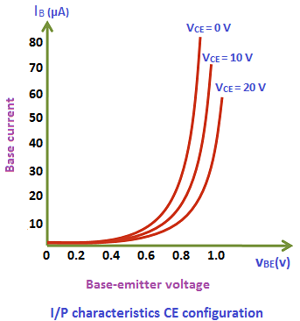
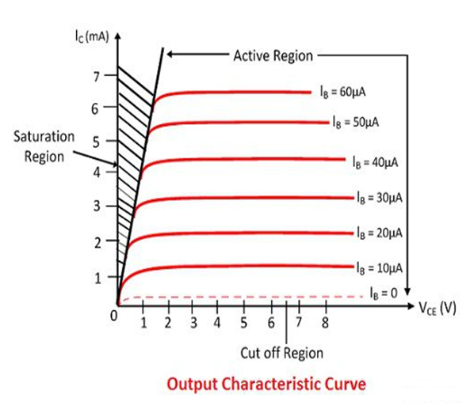
Input Output characteristics of CE Amplifier

Slide 31
Numerical on Diode Current equation
Q.1) Calculate the forward bias current of a Si diode when forward bias voltage of 0.4V is applied, the reverse saturation current is 1.17×10⁻⁹A and the thermal voltage is 25.2mV.

Slide 32
Solution of Q.1)
Equation for diode current I=I₀×(e^{(V/ηV}_{T}⁾-1)
where I₀ = reverse saturation current η = ideality factor V_{T} = thermal voltage V = applied voltage
Since in this question ideality factor is not mentioned it can be taken as one.
I₀ = 1.17 x 10⁻⁹A, V_{T} = 0.0252V, η = 1, V = 0.4V
Therefore, I= 1.17×10⁻⁹xe^{0.4/0.025} -1 = 9.156mA.

Slide 33
Numerical on Diode Current equation
Q.2) Calculate the reverse saturation current of a diode if the current at 0.2V forward bias is 0.1mA at a temperature of 25°C and the ideality factor is 1.5.

Slide 34
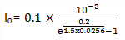
Solution of Q.2)
Explanation:
Equation for diode current I=I₀×(e^{(V/ηV}_{T} ⁾ -1)
where I₀ = reverse saturation current η = ideality factor V_{T} = thermal voltage V = applied voltage
Here, I = 0.1mA, η = 1.5, V= 0.2V, V_{T} = T_{K}/11600 Therefore, V_{T} at T= 25+273=298 is 298/11600 = 0.0256V. Therefore, reverse saturation current I_{O}=0.00055mA = 5.5×10⁻⁷A.

Slide 35
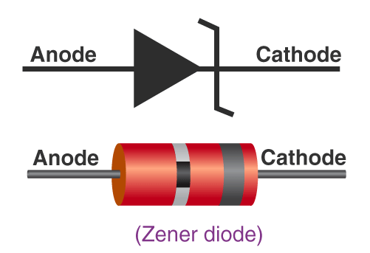

Zener Diode
A special type of device designed to operate in the reverse breakdown region.
is always connected in reverse direction because it is specifically designed to work in reverse direction.
mainly used to protect electronic circuits from over voltage.

Slide 36

VI Characteristics of Zener Diode

Slide 37

Zener Diode as a Voltage Regulator
Zener maintains constant voltage and current to load connected parallel with it.
Input unregulated voltage is dropped by series resistance R
Increased current is conducted by Zener diode

Slide 38



Slide 39

Common Base Configuration

Slide 40


Input Output characteristics of CB Amplifier

Slide 41

Circuit Arrangement to find Input and output characteristics

Slide 42
Common Emitter Configuration

Slide 43
Input Output characteristics of CE Amplifier

Slide 44

Common Collector Configuration

Slide 45


Input Output characteristics of CC Amplifier

Slide 46



Current Amplification Factor
In CC- Current Amplification Factor (ɤ_{dc})

Slide 47



Current Amplification Factor
In CB- Current Amplification Factor (α_{dc}):
For a transistor with common base configuration it is defined as the ratio of static (d.c.) collector current l_{C} to the static emitter current I_{E} at a constant collector voltage with respect to base.
In CE- For a transistor with common emitter configuration it is defined as the ratio of static collector current I_{C} to the static base current I_{B} at a constant collector voltage with respect to emitter.

Slide 48

Relation Between α_{dc} and β_{dc}:

Slide 49

Collector current in terms of leakage current

Slide 50


Slide 51

DC Load Line

Slide 52



Transistor Testing
Using DMM: some DMM’s will measure β_{DC} or hfe.

Slide 53


Junction Field Effect Transistors (JFET)
FET is a semiconductor device which depends for its operation on the control of current by an electric field.

Slide 54



Junction Field Effect Transistor (JFET)

Slide 55


Construction and Characteristics of JFETs
Varying reverse-bias
potentials across the p-n junction
of an n-channel JFET.

Slide 56

Pich-OFF

Slide 57


Construction and Characteristics of JFETs
n-Channel JFET characteristics with IDSS 8 mA and VP4 V.

Slide 58


Slide 59



Configurations of JFET
Common Source
Common Gate
Common Drain
Shockley’s Equation I_{D}=I_{DSS}{1-V_{GS}/V_{p-off}}²

Slide 60
Operating Regions of JFET
Ohmic Region – When V_{GS} = 0 the depletion layer of the channel is very small and the JFET acts like a voltage controlled resistor.
Cut-off Region – This is also known as the pinch-off region when the Gate voltage, V_{GS} is sufficient to cause the JFET to act as an open circuit as the channel resistance is at maximum.
Saturation or Active Region – The JFET becomes a good conductor and is controlled by the Gate-Source voltage, (V_{GS}) while the Drain-Source voltage, (V_{DS}) has little or no effect.
Breakdown Region – The voltage between the Drain and the Source, (V_{DS}) is high enough to causes the JFET’s resistive channel to break down and pass uncontrolled maximum current.

Slide 61

Transfer characteristics of N channel JFET

Slide 62


Transfer characteristics of p channel JFET

Slide 63


Difference between BJT and FET

Slide 64


JFET and BJT

Slide 65



Important equations for DC Analysis of FET

Slide 66



Fixed Bias Configuration

Slide 67



Fixed Bias Configuration

Slide 68


Graphical Analysis of Fixed Bias configuration

Slide 69


Graphical Analysis of Fixed Bias configuration

Slide 70


Example 1

Slide 71


Graphical Approach

Slide 72


Self Bias Configuration

Slide 73


DC Analysis of Self Bias

Slide 74

Mathematical Approach of Self Bias

Slide 75







Graphical Approach
Find two points on the graph

Slide 76

DC Analysis of Self Bias

Slide 77

Reflection Spot
testmoz.com/4954046
https://www.youtube.com/watch?v=uea-BxQR71A
https://www.youtube.com/watch?v=lEy5_reYj2Y

Slide 78



Metal Oxide Semiconductor Filed Effect Transistors (MOSFET)
D-MOSFET – requires the Gate-Source voltage, (V_{GS}) to switch the device “OFF”. The depletion mode MOSFET is equivalent to a “Normally Closed” switch.
E-MOSFET – requires a Gate-Source voltage, (V_{GS}) to switch the device “ON”. The enhancement mode MOSFET is equivalent to a “Normally Open” switch.

Slide 79


Drain and Transfer Characteristics of D-MOSFET and E-MOSFET
Depletion MOSFET
Enhancement MOSFET

Slide 80

Important Equations

Slide 81
Metal Oxide Semiconductor Filed Effect Transistors (MOSFET)
D-MOSFET – requires the Gate-Source voltage, (V_{GS}) to switch the device “OFF”. The depletion mode MOSFET is equivalent to a “Normally Closed” switch.
E-MOSFET – requires a Gate-Source voltage, (V_{GS}) to switch the device “ON”. The enhancement mode MOSFET is equivalent to a “Normally Open” switch.

Slide 82


Construction of DMOSFET n channel and P channel

Slide 83

Working of N channel DMOSFET

Slide 84

Working of EMOSFET

Slide 85
Drain and Transfer Characteristics of D-MOSFET and E-MOSFET
Depletion MOSFET
Enhancement MOSFET

Slide 86
Important Equations

Slide 87
Comparison between BJT, FET and MOSFET
TERMS | BJT | FET | MOSFET
Device type | Current controlled | Voltage controlled | Voltage Controlled
Current flow | Bipolar | Unipolar | Unipolar
Terminals | Not interchangeable | Interchangeable | Interchangeable
Operational modes | No modes | Depletion mode only | Both Enhancement and Depletion modes
Input impedance | Low | High | Very high
Output resistance | Moderate | Moderate | Low
Operational speed | Low | Moderate | High
Noise | High | Low | Low
Thermal stability | Low | Better | High

Slide 88

https://www.youtube.com/watch?v=stM8dgcY1CA
testmoz.com/5056314

Slide 89

Chapter 2 Biasing Circuits of BJTs and MOSFETs
- Mrs Rasika B. Naik

Slide 90
Introduction – Biasing
The analysis or design of a transistor amplifier requires knowledge of both the dc and ac response of the system.
The amplifier increases the strength of a weak signal by transferring the energy from the applied DC source to the weak input ac signal.
The analysis or design of any electronic amplifier therefore has two components:
The dc portion and
The ac portion
During the design stage, the choice of parameters for the required dc levels will affect the ac response.

Slide 91
Biasing
Application of dc voltages to establish a fixed level of current and voltage is called Biasing.
A transistor must be properly biased in order to operate as an amplifier.
DC biasing is used to establish fixed dc values for the transistor currents and voltages called the dc operating point or quiescent point (Q-point).
Purpose of the DC biasing circuit
To turn the device “ON”
To place it in operation in the region of its characteristic where the device operates most linearly .
Proper biasing circuit which it operate in linear region and circuit have centered Q-point or midpoint biased
Improper biasing cause
Distortion in the output signal
Produce limited or clipped at output signal

Slide 92

Effect of Improper Biasing

Slide 93

Operating Point
EMITTER JUNCTION | COLLECTOR JUNCTION | REGION OF OPERATION
Forward biased | Forward biased | Saturation region
Forward biased | Reverse biased | Active region
Reverse biased | Reverse biased | Cut off region

Slide 94

BJT ANALYSIS

Slide 95
DC Biasing Circuits
Fixed-bias circuit
Emitter bias circuit
Voltage divider bias circuit
Collector to base feedback circuit

Slide 96

FIXED BIAS CIRCUIT
This is common emitter (CE) configuration
1st step: Locate capacitors and replace them with an open circuit
2nd step: Locate 2 main loops which;
BE loop (input loop)
CE loop(output loop)

Slide 97

FIXED BIAS CIRCUIT
1st step: Locate capacitors and replace them with an open circuit

Slide 98

FIXED BIAS CIRCUIT
2nd step: Locate 2 main loops

Slide 99


FIXED BIAS CIRCUIT
BE Loop Analysis

Slide 100


FIXED BIAS CIRCUIT
CE Loop Analysis
Note that ^{R}_{C} does not affect the value of Ic

Slide 101
FIXED BIAS CIRCUIT
DISADVANTAGE
Unstable – because it is too dependent on β and produce width change of Q-point
For improved bias stability , add emitter resistor to dc bias.

Slide 102




Effect of circuit values on Q point
Varying Ib

Slide 103


Slide 104


Example 1

Slide 105


Slide 106

EMITTER BIAS CIRCUIT
An emitter resistor, R_{E} is added to improve stability
1st step: Locate capacitors and replace them with an open circuit
2nd step: Locate 2 main loops
BE loop
CE loop
Resistor, RE added

Slide 107

EMITTER BIAS CIRCUIT
1st step: Locate capacitors and replace them with an open circuit

Slide 108

EMITTER BIAS CIRCUIT
2nd step: Locate 2 main loops.

Slide 109


EMITTER BIAS CIRCUIT
BE Loop Analysis

Slide 110


EMITTER BIAS CIRCUIT
CE Loop Analysis

Slide 111


Saturation Level
Load Line Analysis

Slide 112


Example 2

Slide 113

Solution

Slide 114

Solution continued…

Slide 115



Improved Bias Stability
For Fixed Bias Circuit
For Emitter Bias Circuit

Slide 116


Voltage Divider Bias or Potential Divider Bias
Two methods of analyzing a voltage divider bias circuit are:
Exact method : can be applied to any voltage divider circuit
Approximate method : direct method, saves time and energy

Slide 117



Exact Method

Slide 118


Exact Method

Slide 119


Exact Method

Slide 120


Approximate Analysis

Slide 121



Approximate Analysis

Slide 122


Transistor saturation in Voltage divider Bias
The output collector emitter circuit loop of Voltage divider bias circuit is same as that of Emitter bias, so the resulting equation for saturation current (when V_{CE}=0)
Load Line Analysis
Emitter Bias circuit with,

Slide 123

Example 1

Slide 124

Solution
Exact Analysis

Slide 125



Solution
Approximate Analysis

Slide 126

Example 2
Repeat the same example with value of Beta reduced to half i.e. 70

Slide 127


Result comparison when beta changes

Slide 128

Example 3

Slide 129

Solution
In this we can check the difference in the solution if we ignore the condition of approximate analysis or if the condition of approximate analysis is not satisfied.

Slide 130

Solution

Slide 131


Result Comparison

Slide 132

Collector Feedback Bias/ DC bias with Voltage feedback
Improved level of stability can also be obtained by introducing feedback path from collector to base.

Slide 133



DC Analysis
Applying KVL to input loop,
Base Emitter Loop

Slide 134


DC Analysis
Applying KVL to input loop,
Collector Emitter Loop

Slide 135

Saturation
Load Line Analysis

Slide 136

Example 4

Slide 137

Solution

Slide 138

Example 5
Repeat the same example with Beta =135
Solution

Slide 139


Slide 140

Extra Numerical

Slide 141

Solution

Slide 142


Example

Slide 143

Solution

Slide 144

Example

Slide 145



Solution

Slide 146

Example
Beta = 90

Slide 147



Solution

Slide 148

Example

Slide 149

Solution

Slide 150

Example

Slide 151




Solution

Slide 152



Solution continued..

Slide 153


Solution continued..

Slide 154
Design Problems

Slide 155

Example

Slide 156

Solution

Slide 157

Solution continued..

Slide 158


Slide 159

Example

Slide 160



Solution

Slide 161


Example
Beta =110

Slide 162



Solution

Slide 163

Example

Slide 164

Solution

Slide 165

Example

Slide 166


Solution

Slide 167

Example on PNP Transistor

Slide 168






Solution

Slide 169


Slide 170


Slide 171


Slide 172


Slide 173


Slide 174

Stability Factor

Slide 175

Stability Factor
S =
S’ =
S’’ =

Slide 176


Slide 177


Slide 178

Stability Factor for Fixed Bias

Slide 179


Slide 180


Slide 181


Slide 182


Slide 183


Slide 184


Slide 185



Slide 186


Slide 187


Slide 188

Process of Thermal Runaway

Slide 189


Slide 190


Slide 191


Slide 192
JFET and BJT

Slide 193
Important equations for DC Analysis of FET

Slide 194
Fixed Bias Configuration

Slide 195
Fixed Bias Configuration

Slide 196



Fixed Bias Configuration

Slide 197
Graphical Analysis of Fixed Bias configuration

Slide 198
Graphical Analysis of Fixed Bias configuration

Slide 199
Example 1

Slide 200
Graphical Approach

Slide 201
Self Bias Configuration

Slide 202
DC Analysis of Self Bias

Slide 203
Mathematical Approach of Self Bias

Slide 204
Graphical Approach
Find two points on the graph

Slide 205
DC Analysis of Self Bias

Slide 206

Example 2

Slide 207


Solution

Slide 208


Solution continued…

Slide 209

Solution continued…

Slide 210

Example 3

Slide 211

Solution

Slide 212

Example 4

Slide 213


Solution

Slide 214

Solution continued…

Slide 215


Voltage Divider Bias

Slide 216


Voltage Divider Bias

Slide 217


Voltage Divider Bias

Slide 218


Voltage Divider Bias

Slide 219

Voltage Divider Bias

Slide 220

Example 1

Slide 221



Solution

Slide 222

Solution

Slide 223

Example

Slide 224

Solution

Slide 225



Solution

Slide 226

Important equations for DC Analysis of MOSFET
For D-MOSFET
For E-MOSFET

Slide 227



Biasing of E-MOSFET

Slide 228

Transfer characteristics of n-channel EMOSFET

Slide 229

Biasing of E-MOSFET

Slide 230


1. Drain to Gate Bias

Slide 231


1. Drain to Gate Bias

Slide 232

1. Drain to Gate Bias

Slide 233


1. Drain to Gate Bias

Slide 234

Example

Slide 235



Solution

Slide 236

Solution

Slide 237

Solution

Slide 238


2. Potential Divider Bias

Slide 239

2. Potential Divider Bias

Slide 240

Example

Slide 241

Solution

Slide 242

Solution

Slide 243

Solution

Slide 244


Slide 245


Slide 246


Slide 247



